Slide 1
Chapter 10
Statistical Inferences for Two Samples

Slide 2
Introduction
We extend ideas and methods of Chapters 8 and 9 to situations involving the means, variances, and proportions of two different populations.

Slide 3
Inferences about μ₁ - μ₂
Assume
(1) X₁ ,…,X_{m} is a random sample from a
population with mean μ₁ and variance σ₁².
(2) Y₁ ,…,Y_{n} is a random sample from a
population with mean μ₂ and variance σ₂².
(3) The two random samples are independent of
one another.
Notes:
Note that book uses X’s with two subscripts.

Slide 4


Inferences about μ₁ - μ₂
Note: - is the natural point estimator for
μ₁ - μ₂.
Facts: (1) E( - ) = μ₁ - μ₂.
(2) Var( - ) = σ₁²/m + σ₂²/n.
(3) Standard Deviation of - is
square root of Var( - ).

Slide 5
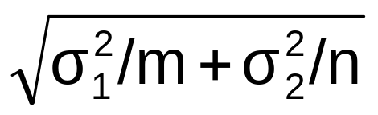
Normal Population, σ₁² and σ₂² known
Here, - ~ N (μ₁ - μ₂, σ₁²/m + σ₂²/n).
Hence, ( - ) - (μ₁ - μ₂) ~ N(0,1).

Slide 6
Normal Population, σ₁² and σ₂² known
Consider testing:
I. H₀: μ₁ - μ₂ ≤ Δ₀ II. H₀: μ₁ - μ₂ ≥ Δ₀
H₁: μ₁ - μ₂ > Δ₀ H₁: μ₁ - μ₂ < Δ₀
III. H₀: μ₁ - μ₂ = Δ₀
H₁: μ₁ - μ₂ ≠ Δ₀

Slide 7
Normal Population, σ₁² and σ₂² known
Test statistic is Z = ( - ) - Δ₀
Reject H₀ when
I. Z ≥ z_{α} II. Z ≤ -z_{α} III. |Z| ≥ z_{α/2}
P-value equals
I. P(Z ≥ z_{OBS}) II. P(Z ≤ z_{OBS}) III. P(|Z| ≥ |z_{OBS}|)

Slide 8
Normal Population, σ₁² and σ₂² known
EXA We want to test to see if IQ’s for men and women are different, on average. We have independent normal random samples. Test at α = .05.
Sample mean σ² sample size
Men 102 225 12
Women 99 225 14
Notes:
1. μ₁ - μ₂ = difference between mean IQ’s for men and women
2. H₀: μ₁ - μ₂ = 0 1 - men
H₁: μ₁ - μ₂ ≠ 0 2 - women
3. T.S. is Z = ( - ) / √ σ₁²/m + σ₂²/n
4. Reject H₀ when |Z| ≥ 1.96
5. z_{OBS} = (102 - 99 ) / √ 225/12+ 225/14 = .51
6. Fail to reject H₀ at α = .05. So there is no evidence that there is a
difference in the mean IQ’s of men and women.
P-value = P(|Z| ≥ |.51|) = 2(.3050) = .6100

Slide 9
Formulas for β and n
Skip “Type II Error and the Choice of Sample Size” section .

Slide 10
Confidence Intervals for (μ₁- μ₂)
-z_{α/2} < ( - ) - (μ₁ - μ₂) < z_{α/2}
iff
( - ) - z_{α/2} < (μ₁ - μ₂) <
( - ) + z_{α/2}

Slide 11
Confidence Intervals for (μ₁- μ₂)
Hence, a 100(1 - α)% c.i. for (μ₁- μ₂) is
( - ) ± z_{α/2} .
Use this c.i. when:
(1) Normal populations, σ₁² and σ₂² known,
any n and m.
(2) Non-normal or unknown populations, σ₁²
and σ₂² known, n and m are large.

Slide 12
Large-Sample Tests
When n and m are large, we do not need the
normal assumption or the known variances
assumption. When σ₁² and σ₂² are unknown,
replace them by s₁² and s₂², respectively.

Slide 13
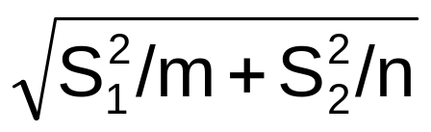
Large Sample Tests
Here, our T.S. is Z = ( - ) - Δ₀ ,
which is approximately N(0,1) when μ₁ - μ₂ = Δ₀ .
Reject H₀ when
I. Z ≥ z_{α} II. Z ≤ -z_{α} III. |Z| ≥ z_{α/2}
Procedures are ok when m > 40 and n > 40.

Slide 14

Large Sample Tests
EXA Let μ₁ and μ₂ denote the true average tread lives for two competing brands of radial tires. Is there evidence that the two means differ. Assume independent random samples. Test at α = .05.
m = 45 = n, = 42500, s₁= 2200, = 40400,
and s₂ = 1900.
Notes:
1. μ₁ - μ₂ = difference between mean tread lives for 2 brands of tires
2. H₀: μ₁ - μ₂ = 0 1 - brand 1
H₁: μ₁ - μ₂ ≠ 0 2 - brand 2
3. T.S. is Z = ( - ) / √ S₁²/m + S₂²/n
4. Reject H₀ when |Z| ≥ 1.96
5. z_{OBS} = (42500 - 40400 ) / √ 4840000/45+ 3610000/45 = 4.85
6. Reject H₀ at α = .05. So there is evidence that there is a
difference in the mean tread lives of the 2 brands of tires.
P-value = P(|Z| ≥ |4.85|) ≈ 0

Slide 15
Large Sample ci’s
When n and m are large and σ₁² and σ₂² are
unknown, a 100(1 - α)% c.i. for (μ₁- μ₂) is
( - ) ± z_{α/2} .

Slide 16
Example
EXA For IQ example, give a 99% c.i. for
(μ₁- μ₂).
Notes:
Sample mean σ² sample size
Men 102 225 12
Women 99 225 14
(102 - 99 ) ± (2.576) √ 225/12 + 225/14 = 3 ± 15.201
→ (-12.201, 18.201)

Slide 17
How to Use c.i. to Test Case III
Note that a c.i. can be used to test
H₀: μ₁ - μ₂ = Δ₀
H₁: μ₁ - μ₂ ≠ Δ₀
Note if Δ₀ is in the c.i. or not. Δ₀ not in c.i. means you reject H₀. Δ₀ in c.i. means you fail to reject H₀.
Notes:
Sample mean σ² sample size
Men 102 225 12
Women 99 225 14
99% c.i.for (μ₁ - μ₂):
(102 - 99 ) ± (2.576) √ 225/12 + 225/14 = 3 ± 15.201
→ (-12.201, 18.201)
H₀: μ₁ - μ₂ = 0
H₁: μ₁ - μ₂ ≠ 0
0 in c.i. means we fail to reject the null hypothesis at α = 0.01.

Slide 18
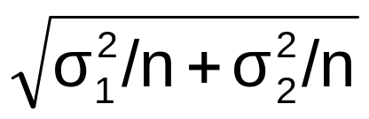
Sample Size for Given L and (1 – α)
Sample size for given length L and confidence level when n = m:
L = 2 z_{α/2}
⇒ n = 4 (z_{α/2}/L)² (σ₁² + σ₂²)
EXA σ₁² = 12 σ₂² = 14 L = 2 95% c.i.
Find n.
Notes:
n = 4 (1.96/2)² (12 + 14) = 99.88 → 100
So n = m = 100.

Slide 19
Two-Sample t Test and C.I.
Assume
(1) X₁ ,…,X_{m} is a random sample from a
N(μ₁, σ²) distribution.
(2) Y₁ ,…,Y_{n} is a random sample from a
N(μ₂, σ²) distribution.
(3) The two random samples are
independent of one another.
(4) σ² is unknown.

Slide 20
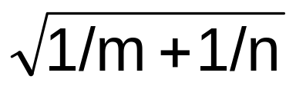
Two-Sample t Test, Common Variance
Defn S_{p}² = [(m-1) S₁² + (n-1) S₂²)]/(n + m - 2)
S_{p}² is called the pooled estimator of σ² .
S_{p} is called the pooled estimator of σ .
Under our assumption,
T = ( - ) - (μ₁ - μ₂) ~ t(n + m - 2)
S_{p}

Slide 21
Two-Sample t Test, Common Variance
Recall the three cases of hypotheses.
Our T.S. is T = ( - ) - Δ₀ .
S_{p}
Reject H₀ when
I. T ≥ t_{α,n+m-2} II. T ≤ -t_{α,n+m-2} III. |T| ≥ t_{α/2,n+m-2}
This is called the pooled t-test.

Slide 22
Two-Sample t Test, Common Variance
EXA Variable of interest is potential drop of a
connector; one sample is wired with alloy
aluminum and a second is wired with EC
aluminum. Test at α = .01 the belief that the
average potential drop for alloy (type 1)
connections is higher than for EC (type 2)
connections. Assume independent normal
populations with common variance.
n= m = 20, = 17.5, = 16.9, s₁ = .55, s₂ = .49
Notes:
1. μ₁- μ₂ = difference between average potential drop for alloy and EC
connections
2. H₀: μ₁ - μ₂ ≤ 0
H_{a}: μ₁ - μ₂ > 0
Note:
3. T.S. is T = - . > qt(.99,38)
S_{p}√(1/m + 1/n) [1] 2.428568
4. Reject H₀ when T ≥ t_{.01,38} ≈ 2.423 Here P-value =
P(T > 3.64) < .0005
5. t_{OBS} = 17.5 - 16.9 = 3.64
(.5209)√(1/20 + 1/20)
S_{p} = √[19(.55)² + 19(.49)² ]/38 = .5209
6. Reject H₀ at α = .01. So data suggests that true average potential
drop for alloy connections is higher than for EC connections.

Slide 23
t-Interval for (μ₁- μ₂)
A 100(1 - α)% c.i. for (μ₁- μ₂) is
( - ) ± t_{α/2,n+m-2} S_{p} .
EXA Find a 95% c.i. for (μ₁- μ₂) in previous
example.
Notes:
(17.5 - 16.9) ± (2.021) (.5209)√(1/20 + 1/20) = .6 ± .333 → (.267, .933)
↑
t_{.025,40}
Note:
> qt(.975,38)
[1] 2.024394

Slide 24
What if σ₁² ≠ σ₂² ?
If the two distributions are not too non-normal
and/or σ₁² and σ₂² are not too different from
each other, the pooled t-test is ok to use.
If σ₁² and σ₂² are very different, don’t use the
pooled t-test especially when n ≠ m.

Slide 25
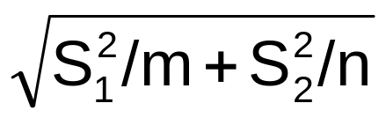
Separate Variance t-test
T.S. is T = ( - ) - Δ₀ ,
where d.f. = ν = (S₁²/m + S₂²/n)² .
(S₁²/m)²/(m-1) + (S₂²/n)²/(n-1)
Chances are ν will not be an integer so round
it down to the nearest integer.

Slide 26
Separate Variance t-test
Reject H₀ when
I. T ≥ t_{α,ν} II. T ≤ -t_{α,ν} III. |T| ≥ t_{α/2,ν}

Slide 27
Separate Variance t-test
EXA An experiment was conducted to compare the mean number of tapeworms in the stomachs of sheep that had been treated for worms against the mean number in those that were untreated. It is believed that the drug will reduce the mean number. Assume independent normal random samples. Test at α = .05.
7 injected with drug: 5, 13, 18, 6, 4, 2,15 (1)
6 untreated: 40, 54, 26, 63, 21, 37 (2)
Notes:
Group Sample Size Sample Mean Sample Variance
1 7 9 38.67
2 6 40.17 258.17
It’s pretty clear that the common variance assumption probably does not hold (we’ll have a test for this later).
1. μ₁- μ₂ = difference between mean number of tapeworms in stomachs
with and without the drug
2. H₀: μ₁ - μ₂ ≥ 0
H_{a}: μ₁ - μ₂ < 0 ν = (38.67/7 + 258.17/6)² = 6.28
(38.67/7)²/6 + (258.17/6)²/5
3. T.S. is T = - .
√ S₁²/m + S₂²/n So ν = 6.
4. Reject H₀ when T <- t_{.05,6} = -1.943 Here P-value =
P(T < -4.47) is between .001 and .0025
5. t_{OBS} = 9 - 40.17 = -4.47
√(38.67/7 + 258.17/6)
6. Reject H₀ at α = .05. So drug appears to work.
Note:
> pt(-4.47,6)
[1] 0.002118716

Slide 28
Different t tests
If we used pooled t-test, we reject H₀ when
T < -t_{.05,11} = -1.796 and t_{OBS} = -4.76.
So here we would have the same conclusion.
But note that the separate variance t-test is
more conservative (it’s harder to reject the
null) than the pooled t-test.
Notes:
t_{OBS} = (9 - 40.17 ) = -4.76
(11.7662)√(1/7 + 1/6)
S_{p} = √[6(38.67) + 5(258.17)]/11 = 11.7662

Slide 29
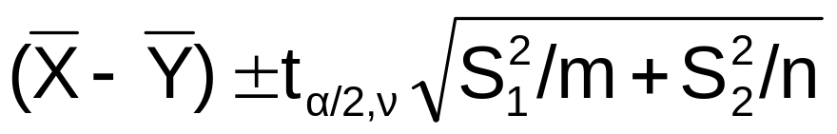
Confidence Interval when σ₁² ≠ σ₂²
A 100(1 - α)% c.i. for (μ₁- μ₂) is
.
EXA Find 95% c.i. for previous example.
Notes:
( 9 - 40.17 ) ± (2.447) √(38.67/7 + 258.17/6)
= -31.17 ± 17.051 → ( -48.221 , -14.119)

Slide 30
β and Choice of Sample Size
We are skipping Section 10-2.3.

Slide 31
Analysis of Paired Data
Here we have two measurements of
observations for n individuals.
EXA Nine people are asked to insert a fine-tipped probe into the eyeholes of 10 needles in rapid succession both for a low light level with a black background and for a higher light level with a white background. Times (in seconds) for the nine subjects using both methods are given.
Notes:
Person 1 2 3 4 5 6 7 8 9
Black 25.85 28.84 32.05 25.74 20.89 41.05 25.01 24.96 27.47
White 18.23 20.84 22.96 19.68 19.50 24.98 16.61 16.07 24.59

Slide 32
Paired Data
The data in previous example is naturally paired.
Assumptions: Let (X₁, Y₁),…,(X_{n}, Y_{n}) be n independent pairs where E(X_{i}) = μ₁ and E(Y_{i}) = μ₂. Let D_{i} = (X_{i} - Y_{i}). D₁,…,D_{n} are independent N(μ₁ - μ₂, σ_{D}²).
Letting μ_{D} = μ₁ - μ₂, use t-test and c.i. as before with D_{i} replacing X_{i}. (Sections 8-2 and 9-3)

Slide 33

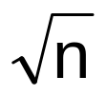
Paired t-test
I. H₀: μ_{D} ≤ Δ₀ II. H₀: μ_{D} ≥ Δ₀ III. H₀: μ_{D} = Δ₀
H₁: μ_{D} > Δ₀ H₁: μ_{D} < Δ₀ H₁: μ_{D} ≠ Δ₀
Test Statistic is T = - Δ₀
S_{D} /
We reject H₀ when
I. T > t_{α,n-1} II. T < -t_{α,n-1} III. |T| > t_{α/2,n-1}
Notes:
Write down P-values in case students have forgot.

Slide 34
Paired t-test Example
EXA Back to fine-tipped probe example. Assume the differences are normal. Test to see if there is evidence that the higher level of illumination yields a decrease of more than 5 seconds in true average task completion time using α = .05.
Go through the 6 steps.
Notes:
Subject 1 2 3 4 5 6 7 8 9
D_{i} = X_{i} - Y_{i} 7.62 8 9.09 6.06 1.39 16.07 8.4 8.89 2.88
(Black - White)
= 7.6 s_{D} = 4.17791
1. Let μ_{D} = μ₁ - μ₂ (mean difference of time: black - white)
2. H₀ : μ_{D} ≤ 5
H_{a} : μ_{D} > 5 6. Reject H₀ at α = .05. Hence, we
evidence to support the claim.
3. T.S. is T = - 5
S_{D} /√n Also, P-value = P(T > 1.867)
is between .025 and .05.
4. Reject H₀ when T > t_{.05,8} = 1.860
Using R
5. t_{OBS} = 7.6 - 5 = 1.867 > pt(-1.867,8)
4.17791/√9 [1] 0.04943087

Slide 35
Use the Correct Test
Note: If we used pooled t-test, the degrees of
freedom would be 16 versus 8.

Slide 36
Confidence Interval for μ_{D}
A 100(1 - α)% c.i. for μ_{D} = (μ₁- μ₂) is
± t_{α/2,n-1} S_{D} /√n .
EXA Find a 95% c.i. for μ_{D} in previous
example.
Notes:
7.6 ± (2.306) (4.17791)/√9 = 7.6 ± 3.211 → (4.389, 10.811)
↑
t_{.025,8}

Slide 37
Inferences about Two Population Variances
Assume that the two populations are normal.
Defn: Let F = (X₁ / ν₁) / (X₂ / ν₂) where
X₁ ~ χ²(ν₁), X₂ ~ χ²(ν₂ ), and X₁ and X₂ are independent. F has a F-distribution with ν₁ numerator degrees of freedom and ν₂ denominator degrees of freedom (F(ν₁, ν₂)).

Slide 38
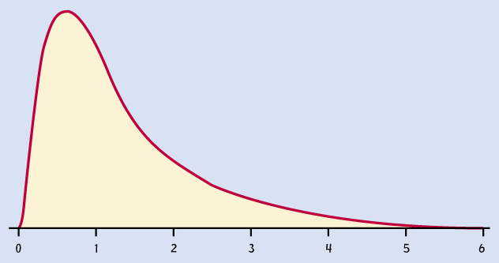
Below is a F(9,10) curve. F distributions are skewed to the right.

Slide 39
F Distribution
Notation: F_{α,ν1,ν2} is the 100(1-α)th percentile
of a F(ν₁, ν₂) distribution.
Note: F_{1-α,ν1,ν2} = 1/F_{α,ν2,ν1}.
See Table VI in Appendix.
EXA Find F_{.05,4,7} and F_{.99,3,9}.
Notes:
Make picture.
F_{.05,4,7} = 4.12
F_{.99,3,9} = 1/ F_{.01,9,3} = 1/27.35 = .03656

Slide 40
F Statistic
Thm Let X₁ ,…,X_{m} be a random sample from a
N(μ₁, σ₁²) distribution and Y₁ ,…,Y_{n} be a random
sample from a N(μ₂, σ₂²) distribution where the
two random samples are independent of one
another. Then
F = (S₁² / σ₁²) / (S₂² / σ₂²) ~ F(m - 1,n - 1).
Notes:
F = ((m - 1)S₁² / σ₁²) /(m - 1) = U/(m -1) , where
((n - 1)S₂² / σ₂²)/(n - 1) V/(n - 1)
U ~ χ²(m - 1), V ~ χ²(n - 1), and U and V are independent.

Slide 41
Hypotheses to be Tested
Consider testing:
I. H₀: σ₁² ≤ σ₂² II. H₀: σ₁² ≥ σ₂²
H₁: σ₁² > σ₂² H₁: σ₁² < σ₂²
III. H₀: σ₁² = σ₂²
H₁: σ₁² ≠ σ₂²

Slide 42
F Test
Test statistic is F = S₁² / S₂² .
If σ₁² = σ₂², F ~ F(m - 1, n - 1).
Reject H₀ when
I. F > F_{α,m-1,n-1} II. F < F_{1-α,m-1,n-1}
III. F > F_{α/2,m-1,n-1} or F < F_{1-α/2,m-1,n-1}

Slide 43
Confidence Interval for σ₁² /σ₂²
A 100(1 - α)% c.i. for σ₁²/σ₂² is
((S₁² / S₂²)/ F_{α/2,m-1,n-1}, (S₁² / S₂²) F_{α/2,n-1,m-1}).
Notes:
F_{1-α/2,m-1,n-1} < (S₁² / S₂²) (σ₂²/σ₁²) < F_{α/2,m-1,n-1} iff
1/F_{α/2,n-1,m-1} < (S₁² / S₂²) (σ₂²/σ₁²) < F_{α/2,m-1,n-1} iff
(S₁² / S₂²)/ F_{α/2,m-1,n-1} < σ₁²/σ₂² < (S₁² / S₂²) F_{α/2,n-1,m-1}

Slide 44
Example
EXA #10.68 on page 413. The variable of interest is the concentration of a particular element in a raw material. In a random sample of size 10 batches from company 1, s₁ = 4.7, and in a random sample of size 16 batches from company 2, s₂ = 5.8. Assuming normal populations and independent random samples, test to see if there is evidence to conclude that the two population variances differ. Use α = 0.05.
Notes:
Test H₀: σ₁² = σ₂²
H₁: σ₁² ≠ σ₂²
T.S. is F = S₁² / S₂² .
Reject H₀ when F > F_{.025,9,15} = 3.12 or F < 1/F_{.025,15,9} = 1/3.77 = .2653
F_{OBS} = (4.7/5.8)² = 0.6567
So we fail to reject H₀ at α = .05. So there is no evidence against
σ₁² = σ₂² .
Note:
> qf(.975,9,15)
[1] 3.122712
> qf(.025,9,15)
[1] 0.2652972

Slide 45
Example
EXA Because there is no evidence to conclude that the two population variances differ, we would use the pooled t-test if we wanted to do a test concerning the two population means.

Slide 46
Example
EXA #10.68 on page 413. The variable of interest is the concentration of a particular element in a raw material. In a random sample of size 10 batches from company 1, s₁ = 4.7, and in a random sample of size 16 batches from company 2, s₂ = 5.8. Find a 95% c.i. for σ₁²/σ₂² .
Notes:
( (S₁² / S₂²)/ F_{α/2,m-1,n-1} , (S₁² / S₂²) F_{α/2,n-1,m-1})
= ( ((4.7)² / (5.8)²)/ F_{.025,9,15} , ((4.7)² / (5.8)²) F_{.025,15,9})
= ( ((4.7)² / (5.8)²)/ 3.12 , ((4.7)² / (5.8)²) 3.77)
= (0.2105, 2.4756)
Also, a 95% c.i. for (σ₁ / σ₂) is (√0.2105, √2.4756) = (0.4588, 1.5734)
Note:
> qf(.975,15,9)
[1] 3.769357

Slide 47
Example
To test H₀: σ₁² = σ₂²
H₁: σ₁² ≠ σ₂²
Consider testing H₀: σ₁² / σ₂² = 1
H₁: σ₁² / σ₂² ≠ 1
If 1 is not in the c.i., reject H₀. If 1 is in the c.i., fail to reject H₀.
Notes:
A 95% c.i. for σ₁²/σ₂² is (0.2105, 2.4756).
Because 1 is in the 95% c.i., we fail to reject H₀ at α = 0.05.

Slide 48
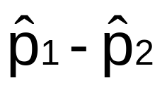
Inferences on Two Proportions
Assume: X is Bin(m,p₁), Y is Bin(n,p₂), and X
and Y are independent.
Fact: E( ) = p₁ - p₂
Var( ) = p₁(1 - p₁)/m + p₂(1 - p₂ )/n
So is an unbiased estimator of p₁ - p₂.
Notes:
Define the p-hats.

Slide 49
Testing Hypotheses
Consider testing:
I. H₀: p₁ - p₂ ≤ 0 II. H₀: p₁ - p₂ ≥ 0
H₁: p₁ - p₂ > 0 H₁: p₁ - p₂ < 0
III. H₀: p₁ - p₂ = 0
H₁: p₁ - p₂ ≠ 0

Slide 50


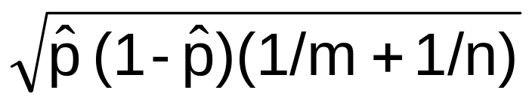

Test Statistic
Assume m , m(1 - ), n , and n(1 - )
are at least 10.
Test statistic is
Z = ________________
where = (X + Y)/(m + n).

Slide 51
Rejection Region
Reject H₀ when
I. Z ≥ z_{α} II. Z ≤ -z_{α} III. |Z| ≥ z_{α/2}
EXA Urban versus rural. Let S denote that a resident favors increasing highway speed limit from 55 to 65 mph. Does data indicate that the sentiment for increasing the speed limit differs for the two groups of residents? Test at α = .05.
Urban: m=300, x = 63 Rural: n=180, y = 75
Notes:
(1) Urban: m=300, x = 63 (2) Rural: n=180, y = 75
1. p₁ - p₂ = difference of the two proportions (urban - rural)
2. H₀: p₁ - p₂ = 0
H_{a}: p₁ - p₂ ≠ 0 = 63/300 = .21
= 75/180 = .4167
3. T.S. is Z = __________________
= (63 + 75)/(300 + 180)
= .2875
4. Reject H₀ when |Z| > 1.96.
5. z_{OBS} = .21 - .4167 = -4.84 (Here P-value ≈ 0)
√(.2875)(.7125)(1/300 + 1/180)
6. Reject H₀ at α = .05. So there is evidence that the sentiment for
increasing the speed limit is different for the 2 groups of residents.

Slide 52
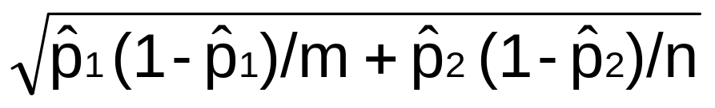
Confidence Interval for p₁ - p₂
Assume m , m(1 - ), n , and n(1 - )
are at least 10.
A 100(1 - α)% c.i. for (p₁ - p₂) is
± z_{α/2}

Slide 53
Example
EXA Find a 95% c.i. for (p₁ - p₂) in the previous
example.
Notes:
(.21 - .4167) ± (1.96)√(.21)(.79)/300 + (.4167)(.5833)/180
= -.2067 ± .0855 → (-.2922, -.1212)
(so we can see why we rejected the null hypothesis)

Slide 54
Summary
See summary table on page 421.

